Slide 1
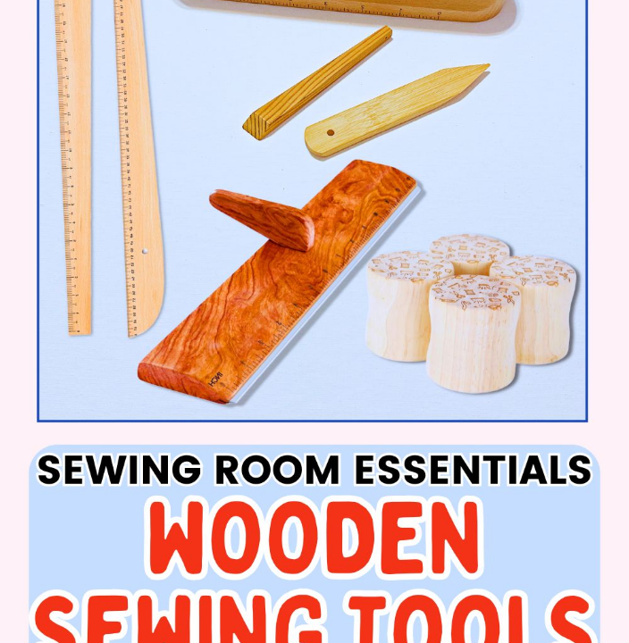
PROJECT SHOWCASE
Why Buy When You Can Rent?
How I built VærktøjLeje: Denmark's handiest tool-sharing web app.

Slide 2






My Simple 3-Step Recipe
Solving the classic DIY headache for local residents.
The Tool Stash
MitID Magic
Dirt-Cheap Rates
Curated digital catalog from drills to ladders.
Secure CPR checks built right into the modal.
Nominal daily fees to fix household flats.

Slide 3


Built With Love
& Vanilla Code
No Framework Bloat 100% plain HTML and JavaScript.
Tailwind Styling Utility classes for responsive, modern design.
Ready to Ship Pushed seamlessly to my GitHub repository.

